Slide 1

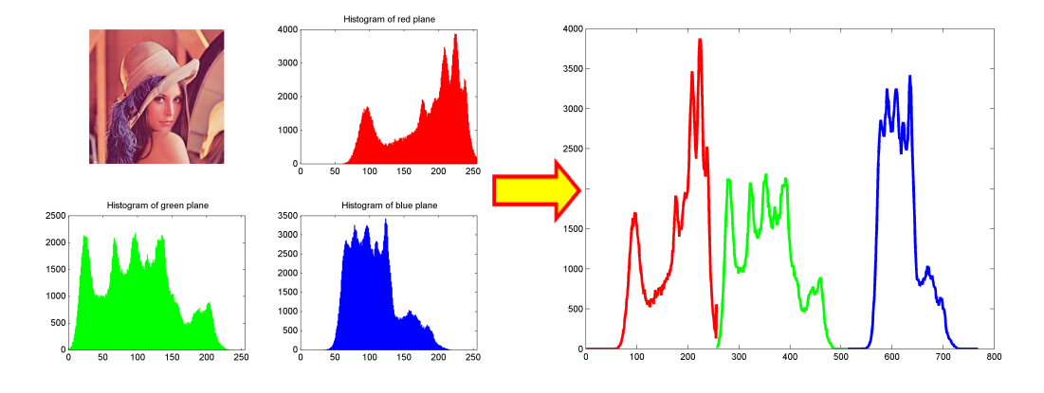
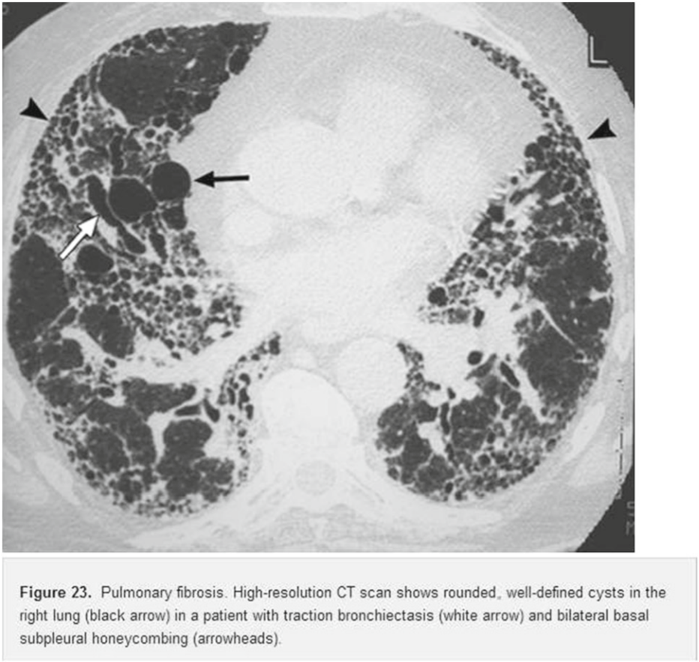
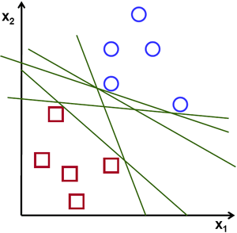
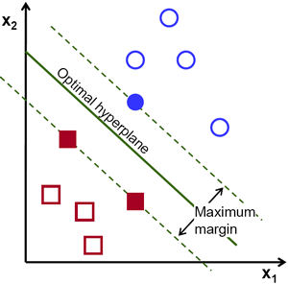
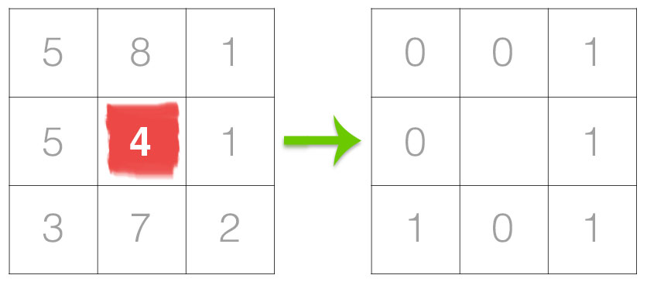
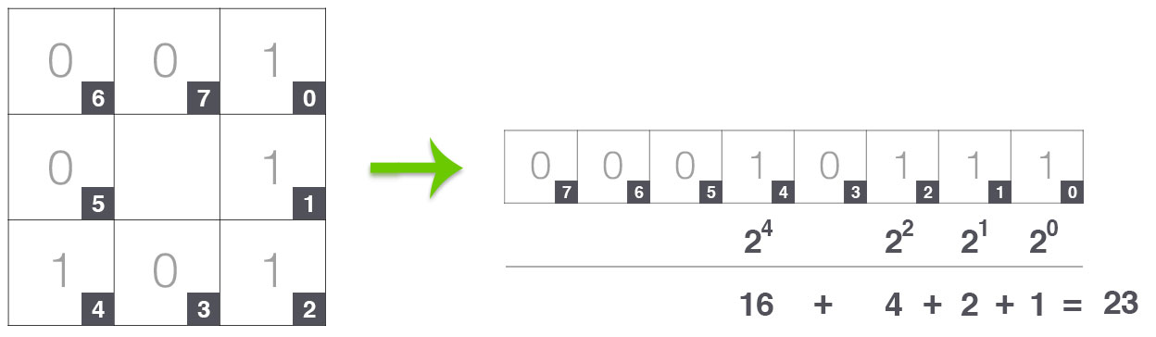
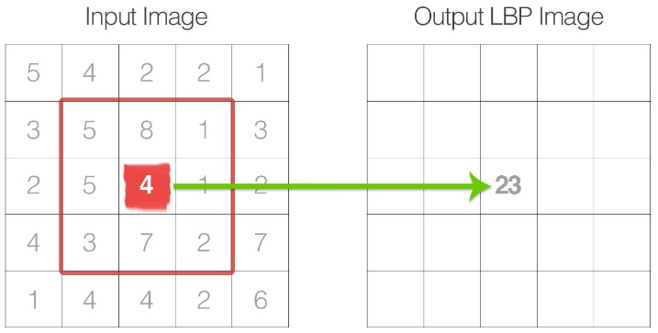
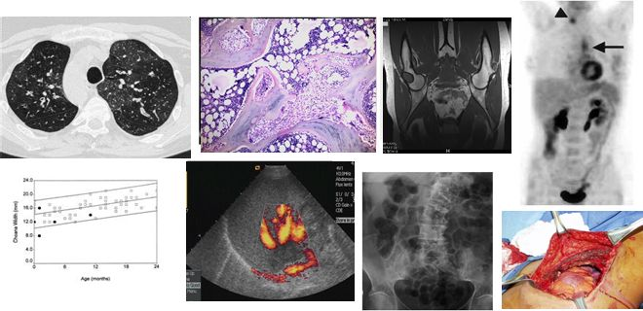
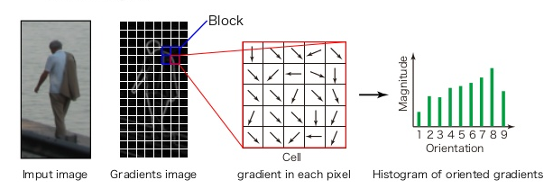
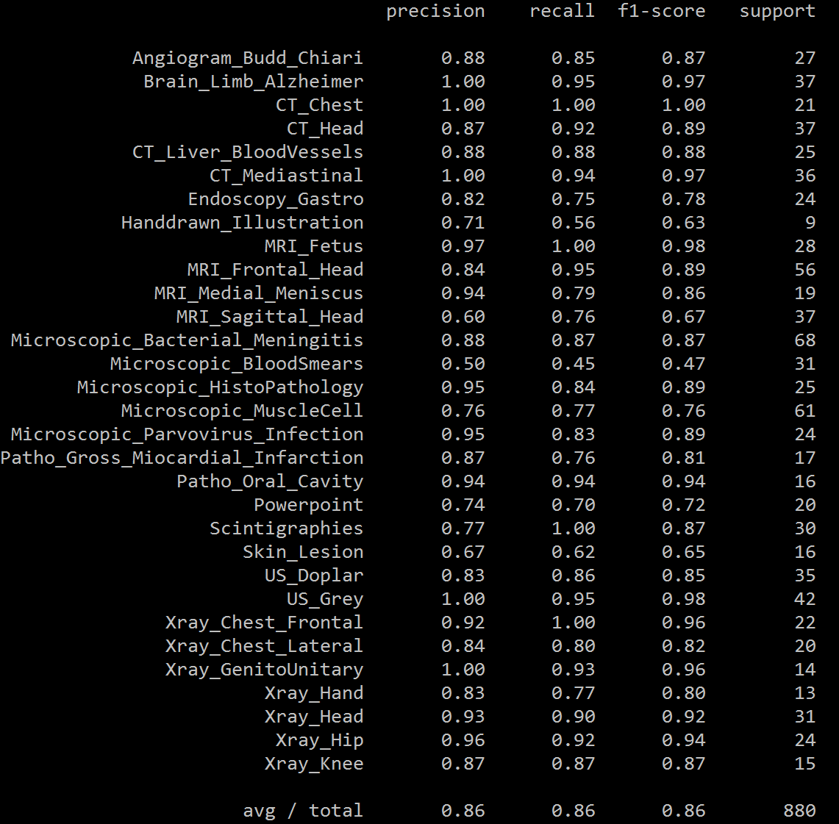
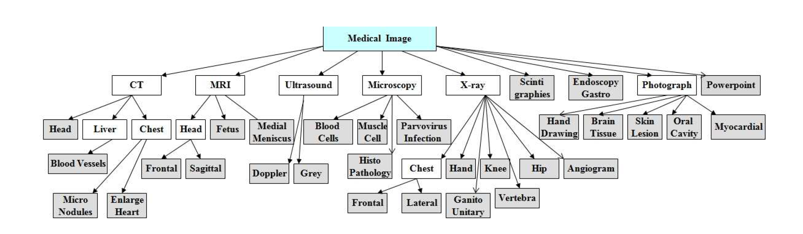
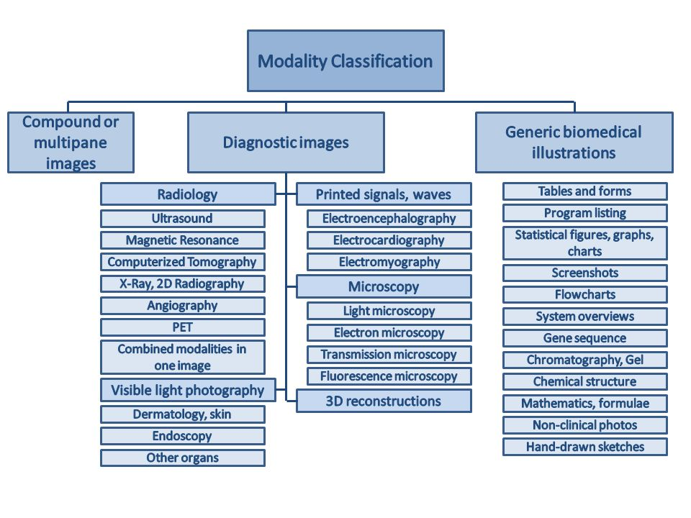
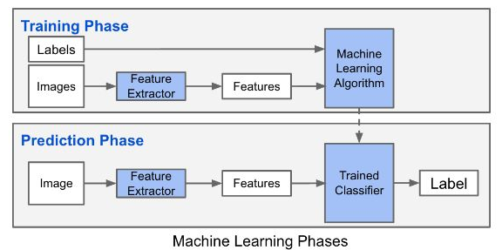
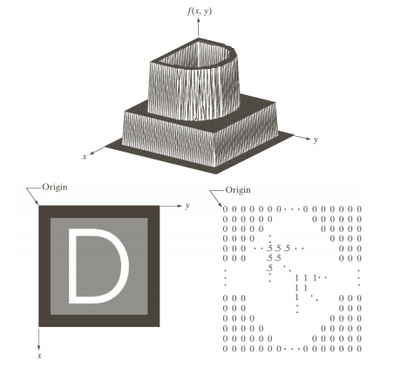
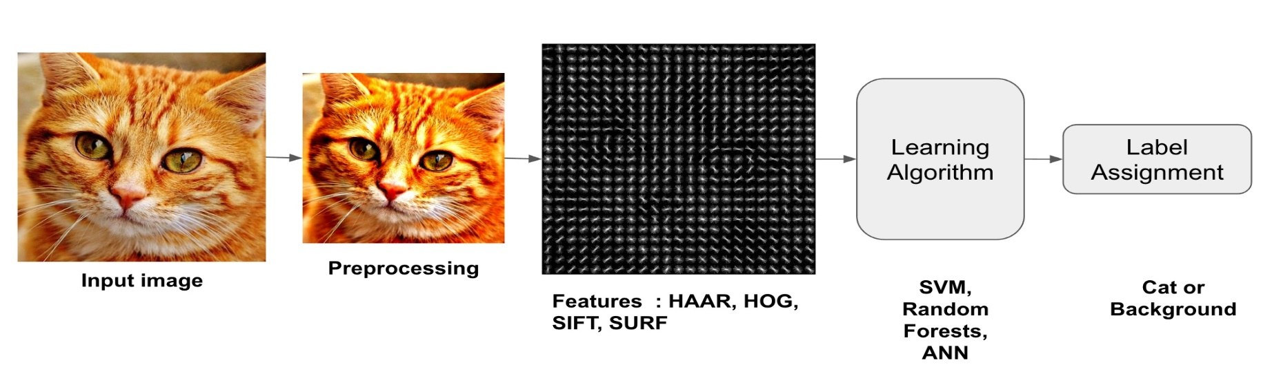
Modality Detection and Classification of Images from Biomedical Articles
Using Image Processing and Machine Learning in Python
Jose Dixon, Mahmudur Rahman, Ph.D. (Mentor)
Computer Science Department, Morgan State University, Baltimore, Maryland
Biomedical Literature
Visual Feature Extraction
Supervised Classification
Biomedical images of diverse modalities constitute an important source of anatomical and functional information.
These images are also frequently used in Biomedical Articles.
Overall, biomedical literature incorporates an approximation of 100 Million Figures.
The classification of images based on
modality is one important module in
medical image retrieval systems.
It can provide an option to limit
the search space and improve the
retrieving performance of the system.
Feature extraction plays key role in classification process.
Features of an image reveal its basic attributions and characteristics.
The obtained features must be acceptable in size for applicability and computationally efﬁcient.
Classification is the task of choosing the correct class label for a given input. In basic classification tasks, each input is considered in isolation from all other inputs, and the set of labels is defined in advance.
A classifier is called supervised if it is built based on training corpora containing the correct label for each input.
Classification Techniques: Support Vector Machine (SVM), Random Forest Classifier, Multinomial Naive Bayes Classifier
Color Histogram:
Local Binary Pattern (LBP):
LBPs compute a local representation of texture.
This local representation is constructed by comparing each pixel with its surrounding neighborhood of pixels.
SVM is a discriminative classifier formally defined by a separating hyperplane.
In other words, given labeled training data (supervised learning), the algorithm outputs an
optimal hyperplane which categorizes new examples.
Example Image with Caption
Experiments & Result Analysis
Objective
For experimental analysis, we used a dataset of
5000 images from ImageCLEFmed collections.
Images are classified into 30 manually assigned
disjoint global categories.
Training and Test sets (80% and 20% of the data set)
Accuracies are compared using different classification techniques in a combined feature space of color histogram, LBP and HOG features.
It is challenging to find a unique feature to represent all kinds of images. Feature descriptors at different levels of abstraction are often in diverse forms and complementary in nature.
Hence, the simultaneous use of different features might lead to a better classification result.
In existing research, the category information is only limited to imaging modality (e.g., X-ray, MRI, Ultrasound, etc.), which is typically extracted from image caption and is often not correct or present.
Goldminer and Yottalook allow users to limit
the search results to a particular modality only.
Presents a Biomedical Image Classification approach at different levels by combining multiple color, texture and edge related features.
The last step is to compute a histogram over the output LBP array. Since a 3 x 3 neighborhood
has 2 ^ 8 = 256 possible patterns, allowing us to construct a 256-bin histogram.
Histogram of Oriented Gradients (HOG):
Good for object detection.
Gradient magnitude accumulates in each orientation within a local region.
Process Flow Diagram
In this collection, images are classified into
three hierarchical levels according to the
imaging modalities, body part and specific
orientation or visual observation
Result of SVM Classification
Digital Image Representation
Classifier | Precision | Recall | F1-score
Multinomial Naive Bayes | 0.51 | 0.47 | 0.40
Random Forest | 0.82 | 0.80 | 0.80
SVM | 0.86 | 0.86 | 0.86
A digital image is an image f(x,y) that has been discretized
both in spatial coordinate and brightness F(x,y)=I(x,y)r(x,y)
For Image/ Processing and Classification, Python 2.7, OpenCV 3 and scikit-learn 0.18 libraries are used.
References
Conclusion & Future Work
Herrera, Alba Garcia Seco, and Jayashree Kalpathy-Cramer. “AMIA: Medical task.” ImageCLEF / LifeCLEF - Multimedia Retrieval in CLEF, ImageCLEF, 29 Oct. 2017, www.imageclef.org/2013/medical.
Rosebrock, Adrian. “Local Binary Patterns with Python & OpenCV.” Pyimagesearch.com, Pyimagesearch.com, 29 Oct. 2017, www.pyimagesearch.com/2015/12/07/local-binary-patterns-with-python-opencv/.
Rosebrock, Adrian. “HOG detectMultiScale parameters explained.” Pyimagesearch , Pyimagesearch.com, 29 Oct. 2017, www.pyimagesearch.com/2015/11/16/hog-detectmultiscale-parameters-explained/.
Modality detection is an essential task to enhance the performance of a medical image retrieval system.
In future, we will experiment with a larger dataset and explore image classification using Deep Neural Networks.

